Slide 1
Schema Migrations

Slide 2
Objectives
Schema Changes
Schema Changes in RDBMS
Migrations for Green Field Projects
Migrations in Legacy Projects
Schema Changes in a NoSQL Data Store
Incremental Migration
Migrations in Graph Databases
Changing Aggregate Structure

Slide 3
Schema Changes
NoSQL databases is to highlight their schemaless nature—it is a popular feature that allows developers to concentrate on the domain design without worrying about schema changes.
It’s especially true with the rise of agile methods where responding to changing requirements is important.
With NoSQL data stores, changes to the schema can be made with the least amount of friction, improving developer productivity requires careful attention

Slide 4
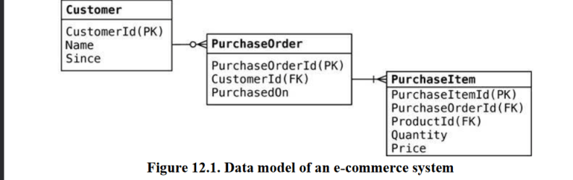
Schema Changes in RDBMS
While developing with standard RDBMS technologies, we develop objects, their corresponding
tables, and their relationships.

Slide 5
Schema Changes in RDBMS
The first time there is a change in the object model,
such as introducing preferredShippingType on the Customer object, we have to change the object and change the database table, because without changing the table the application will be out of sync with the database.
When we get errors like ORA-00942: table or view does not exist or ORA-00904: "PREFERRED_SHIPPING_TYPE": invalid identifier, we know we have this problem.

Slide 6
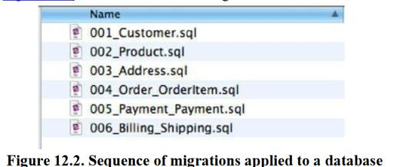
Migrations for Green Field Projects
Green Field Projects : it is a project that begins from scratch without any existing systems or databases in place.
Scripting the database schema changes during development is better, since we can store these schema changes along with the data migration scripts in the same script file.
These files should be named as per database versions; for example, 001_ Description_Of_Change.sql.

Slide 7
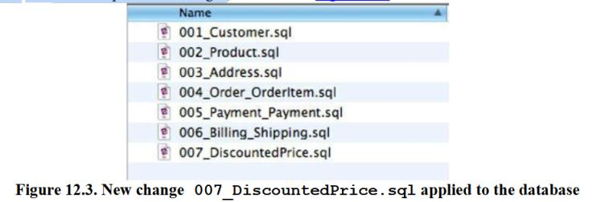
Migrations for Green Field Projects
suppose we need to change the OrderItem table to store the DiscountedPrice and the FullPrice of the item.
This will need a change to the OrderItem table and will be change number 007 in our sequence of changes

Slide 8
Shown below is the script contained in the change 007_DiscountedPrice.sql:
ALTER TABLE orderitem ADD discountedprice NUMBER(18,2) NULL;
UPDATE orderitem SET discountedprice = price;
ALTER TABLE orderitem MODIFY discountedprice NOT NULL;
ALTER TABLE orderitem RENAME COLUMN price TO fullprice; --//@UNDO
ALTER TABLE orderitem RENAME fullprice TO price;
ALTER TABLE orderitem DROP COLUMN discountedprice;
The change script shows the schema changes to the database as well as the data migrations needed
to be done.

Slide 9
DBDeploy
The framework to manage the changes to the database.
DBDeploy maintains a table in the database, named ChangeLog, where all the changes made to the database are stored.
In this table, Change_Number is what tells everyone which changes have been applied to the database.
This Change _Number, which is the database version, is then used to find the corresponding numbered script in the folder and apply the changes which have not been applied yet.
When we write a script with the change number 007 and apply it to the database using DBDeploy, DBDeploy will check the ChangeLog and pick up all the scripts from the folder that have not yet been applied.

Slide 10
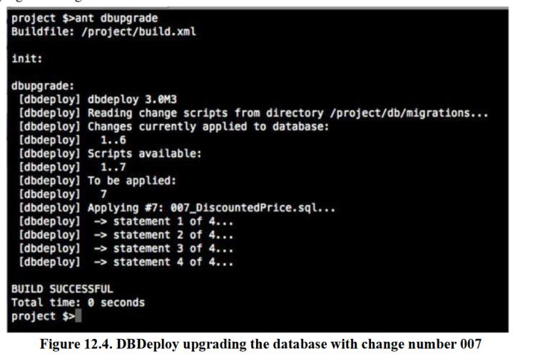

Slide 11
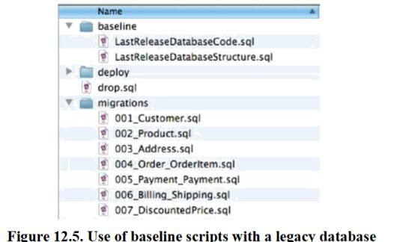
Migrations in Legacy Projects
We found that taking an existing database and extracting its structure into scripts, along with all the database code and any reference data, works as a baseline for the project.
This baseline should not contain transactional data.
Once the baseline is ready, further changes can be done using the migrations technique.

Slide 12
Migrations in Legacy Projects
In many enterprises →multiple applications using the database; when we change the database for one application, this change should not break other applications.
We can achieve backward compatibility by maintaining a transition phase for the change, as described in detail in Refactoring Databases.
During a transition phase, the old schema and the new schema are maintained in parallel and are available for all the applications using the database.
So, we have to introduce scaffolding code, such as triggers, views, and virtual columns ensuring other applications can access the database schema and the data they require without any code changes.

Slide 13
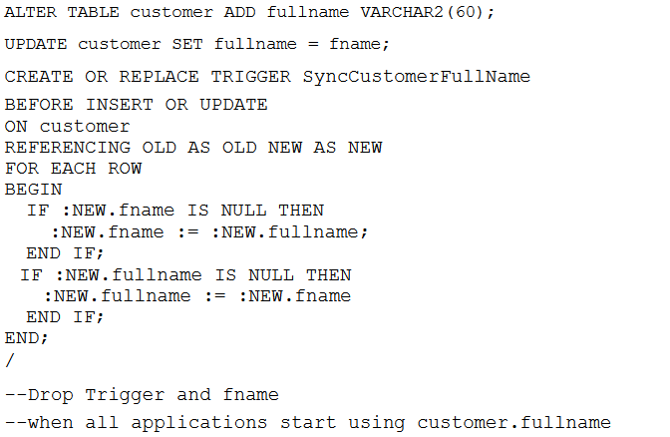
example

Slide 14
trying to rename the customer.fname column to customer.fullname as we want to avoid any ambiguity of fname meaning either fullname or firstname.
A direct rename of the fname column and changing the application code we are responsible for may just work, for our application—but will not for the other applications in the enterprise that are accessing the same database.
Using the transition phase technique, we introduce the new column fullname, copy the data over to fullname, but leave the old column fname around.
We also introduce a BEFORE UPDATE trigger to synchronize data between the columns before they are committed to the database.
Now, when applications read data from the table, they will read either from fname or from fullname but will always get the right data.
We can drop the trigger and the fname column once all the applications have moved on to using the new fullname column.

Slide 15
Schema Changes in a NoSQL Data Store
When developing with NoSQL databases, in some cases the schema does not have to be thought about beforehand.
We still have to design and think about other aspects,
such as the types of relationships (with graph databases), or the names of the column families, rows, columns, order of columns (with column databases), or how are the keys assigned and what is the structure of the data inside the value object (with key-value stores).
Even if we didn’t think about these up front, or if we want to change our decisions, it is easy to do so.

Slide 16
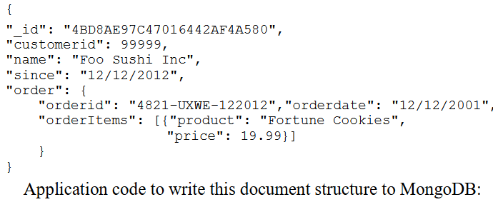
Schema Changes in a NoSQL Data Store
For the sake of simplicity, assume we are using a document data store like MongoDB

Slide 17
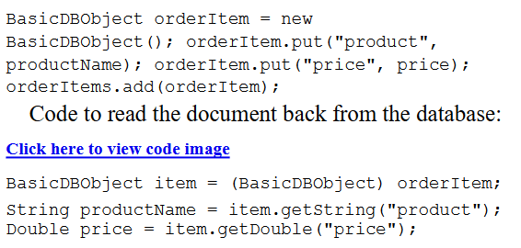
Schema Changes in a NoSQL Data Store

Slide 18
Incremental Migration
Schema mismatch trips many new converts to the NoSQL world.
When schema is changed on the application, we have to make sure to convert all the existing data to the new schema .
Incremental migration: Another option would be to make sure that data, before the schema changed, can still be parsed by the new code, and when it’s saved, it is saved back in the new schema.
It Migrate data over time; some data may never get migrated, because it was never accessed

Slide 19
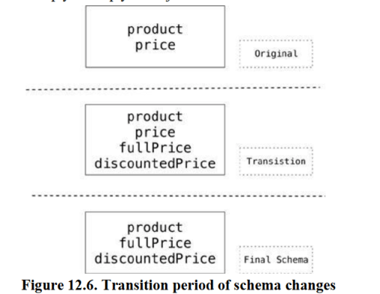
The incremental migration technique will complicate the object design, especially as new changes are being introduced yet old changes are not being taken out.
This period between the change deployment and the last object in the database migrating to the new schema is known as the transition period.

Slide 20
Migrations in Graph Databases
Graph databases have edges that have types and properties.
If you change the type of these edges in the codebase, you no longer can traverse the database, rendering it unusable.
To get around this, you can traverse all the edges and change the type of each edge.
This operation can be expensive and requires you to write code to migrate all the edges in the database.

Slide 21
Migrations in Graph Databases
If we need to maintain backward compatibility or do not want to change the whole graph in one go, we can just create new edges between the nodes; later when we are comfortable about the change, the old edges can be dropped.
We can use traversals with multiple edge types to traverse the graph using the new and old edge types.
This technique may help a great deal with large databases, especially if we want to maintain high availability.

Slide 22
Changing Aggregate Structure
Sometimes you need to change the schema design, for example by splitting large objects into smaller ones that are stored independently.
i.e. customer aggregate that contains all the customers orders, and you want to separate the customer and each of their orders into different aggregate units.
You then have to ensure that the code can work with both versions of the aggregates.
If it does not find the old objects, it will look for the new aggregates.
Code that runs in the background can read one aggregate at a time, make the necessary change, and save the data back into different aggregates.
The advantage of operating on one aggregate at a time is that this way, you’re not affecting data availability for the application.

